Slide 1
NAWN
ANNUAL MEETING
April 26, 2023

Slide 2
Current NAWN Leadership: June 2022 - May 2023 Board & Committee Leads
VOTING BOARD:
President: Jackie MacLaren
Vice President: Chandra Verbic
Treasurer: Piper Wright
Secretary: Andrea Wiltrout
Communications: Jamie Curtis
Operations: Tiffany Colucci
Events: Lauren Amery & Nichol Butsky
Social: Erin Spalding
Membership: Jenn Fuller & Lauren Shadwick
Sponsorship: Stephanie Clinker
Beneficiary: Sarah Aklilu
Past President: Terri Erlenbach
COMMITTEE LEADS:
Book Clubs: Rebecca Rhoads
SWANS: Karen Lackey & Bryn Challacombe
Playgroups: Open
Elevate (Professionals): Courtney Marx
Volunteerism &
Neighborhood: Sarah Mullendore & Kristen Pietro
Social Media: Lauren Amery
Thank you to our outgoing leadership, for your time and talents!
We appreciate all that you do for NAWN and our community!

Slide 3
Proposed NAWN Leadership: June 2023 - May 2024 Board & Committee Leads
VOTING BOARD:
President: Jackie MacLaren
Vice President: Chandra Verbic
Treasurer: Piper Wright
Secretary: Andrea Wiltrout
Communications: Jamie Curtis
Operations: Tiffany Colucci
Events: Lauren Amery & Nichol Butsky
Social: Erin Spalding
Membership: Jenn Fuller & Lauren Shadwick
Sponsorship: Stephanie Clinker
Beneficiary: Betsy Mable
Past President: Terri Erlenbach
COMMITTEE LEADS:
Book Clubs: Sarah Aklilu
SWANS: Karen Lackey & Bryn Challacombe
Playgroups: Open
Elevate (Professionals): Courtney Marx
Volunteerism &
Neighborhood: Sarah Mullendore & Kristen Pietro
Social Media: Lauren Amery
Communications Assistant: Candice Siegenthaler
Social Assistant: Shelly Deegan

Slide 4
The New Albany Women’s Network exists to provide a network for all individuals who live, work or have an interest in New Albany, and to enrich and foster a united, strong community through various social, charitable, educational and community outreach opportunities.
Through the power of our organization, the dedication of our time and the combination of our efforts, we strive to create a strong community for all who live, and work in New Albany.
NAWN 2023
206 Members Strong
We’re committed to bettering the lives of women and children in and around New Albany.
Notes:
updated

Slide 5
Key Highlight for 2022 Fashion Show
Our annual Fire and Ice themed Fashion Show showcased local boutiques’ latest trends and our NAWN members in their best attire! More than 200 attended and enjoyed a fabulous night at the New Albany Ballet Company
We provided the show’s beneficiary, Sanctuary Night, their requested $20,000; our support helped them fund new bathrooms and health care services for women seeking their help/support
2023 event date and location will be announced soon
Notes:
updated

Slide 6
Key Financials
2022 Operating Budget was $10,500 (2023 is $9,000)
Budget is used for local donations to various causes throughout the year, social and special group events/needs, general administrative items, communications and web support.
Endowment Fund is $208,000
$7,000 was raised for NAWN’s Endowment Fund as a result of the 2022 An Evening in New Albany event.
Focus on Local Giving in 2022
$5,000 was provided to support New Albany School’s Pay-to-Play program and 4,000 was awarded in scholarships to two graduating seniors from New Albany High School.
Membership Growth
61 new members and 132 renewals

Slide 7
Thank you to our Sponsors
Thank you to our generous sponsors for helping make 2022-23 an impactful year for the community!
Our sponsors helped our efforts to support Sanctuary House and the New Albany Neighborhood Bridges Program.
An Evening in New Albany Sponsors:
Platinum: New Albany Chamber and CVG
Silver: Barre 3, Envisage Wealth/Ameriprise Financial, F45, Maple Orthodontics, Premier Dental of Ohio and Trilogy Health Services
Fashion Show Sponsors:
Platinum: Maple Orthodontics
Silver: Barre 3

Slide 8
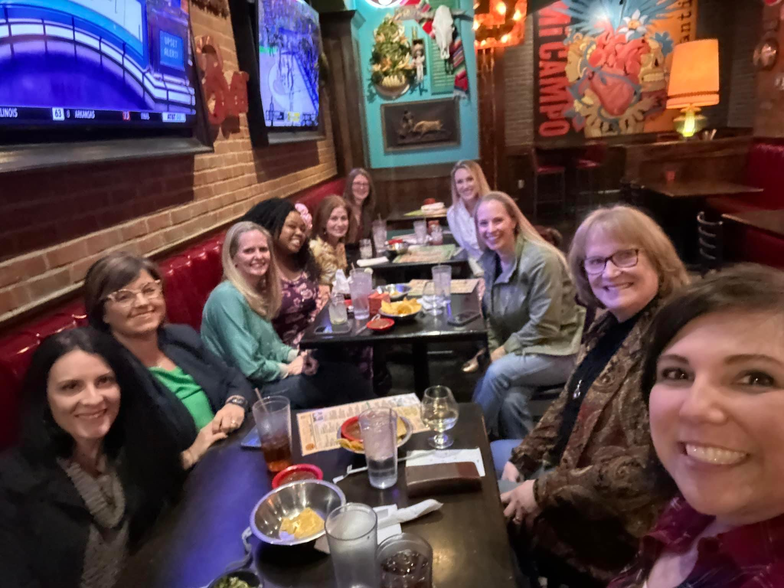
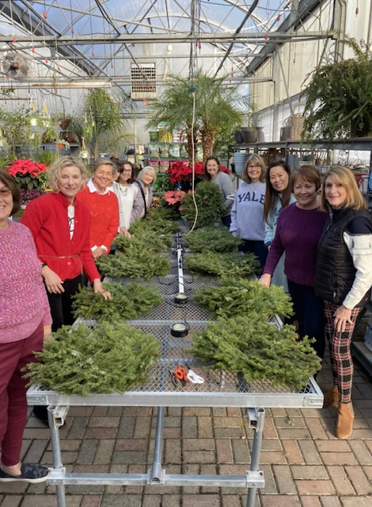
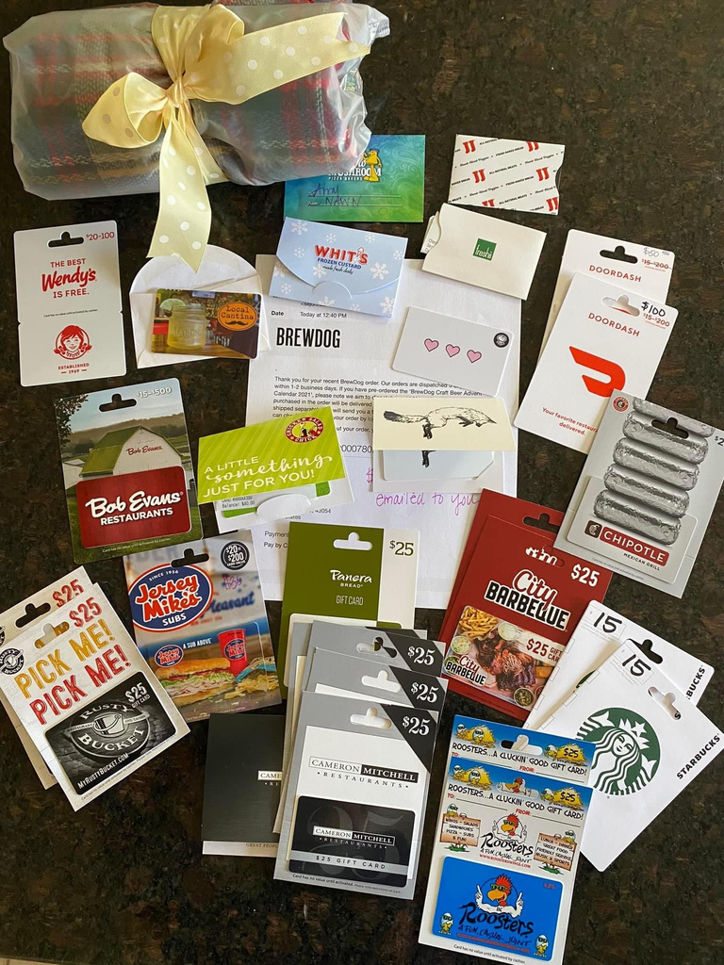
NAWN’s Special Interest Groups
Socials: Monthly opportunities to get together
Books Clubs: 12 active groups that meet monthly
Playgroups: Scheduled meet-up, activities (ranging from infants to first grade)
SWANS: Meets monthly (normally during the day) for a broad range of fun, engaging activities
Elevate (Professionals Group): Meets monthly to learn, network and share best practices
Neighborhood Outreach: Provides families/ community members in need with meals, gift cards or special care packages
Coming soon!
New walking and card-playing groups

Slide 9
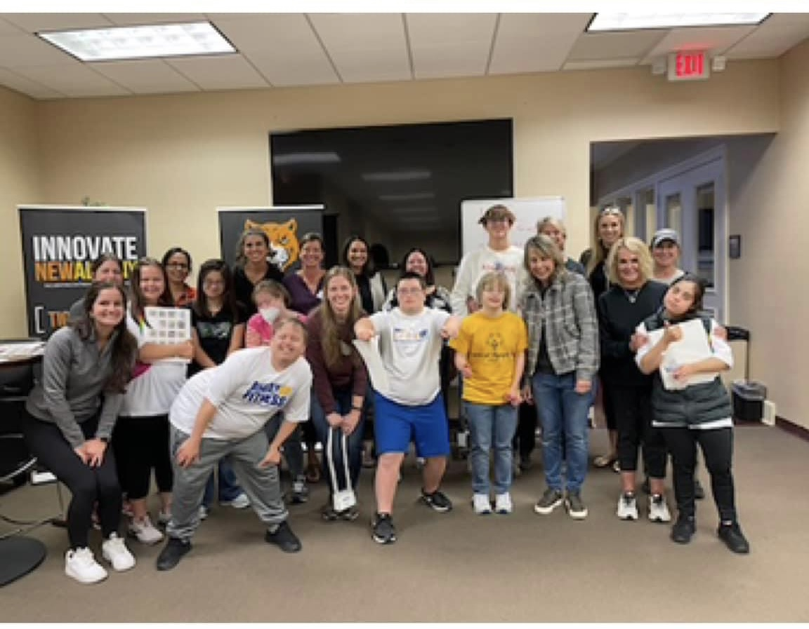
Volunteerism Focus
Volunteered, collected and donated supplies to the New Albany Food Pantry
Regular volunteer for Buddy Up For Life Communications Class
Cheered on walkers at the New Albany Walking Classic
Active participation in New Albany’s Neighborhood Bridges program
Participated in the Parks and Rec Trunk or Treat event
Coordinated our Annual Adopt-a-Family with Directions for Youth and Families; provided gifts to 4 well deserving families
Helped with Gingerbread House Workshops with Healthy New Albany

Slide 10
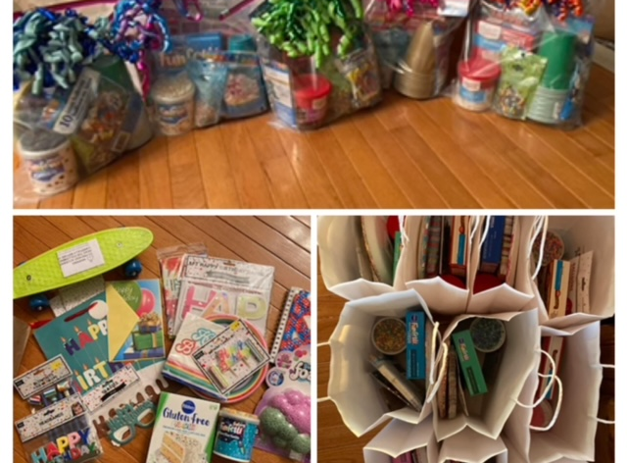
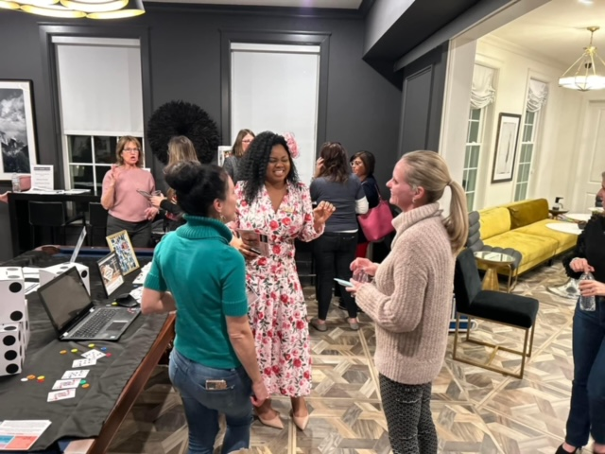
Early 2023 Highlights
Conducted a Member Survey (January-March)
Participated in a Blanket Drive for the homeless (January)
Hosted a cozy Social night in (February)
Donated Birthday Bags to the New Albany Food Pantry (February/March)
Organized Galentine Valentine Package Matches (February)
Held a Mardi Gras Mixer (February)
Held our annual Open House (March)
Held annual An Evening in New Albany (April)

Slide 11
Visit our new website: NAWN.org
“Like” us on Facebook
“Join” our closed Facebook Group - “NAWN Chat”
“Follow” on Instagram
“Follow” us on LinkedIn
THANK
YOU

